Slide 1
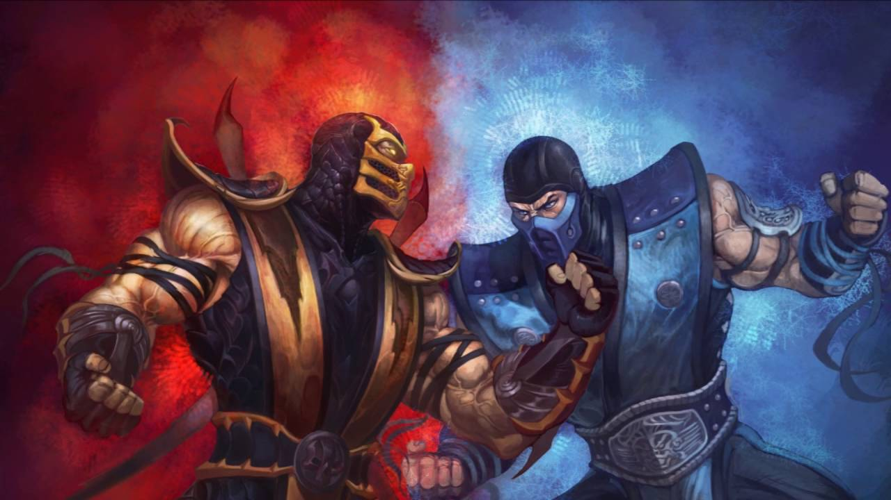
CES-22 POO/Comp21
Adriano Soares
Matheus Vidal
Pedro Alves

Slide 2

Steps
The Idea

Slide 3
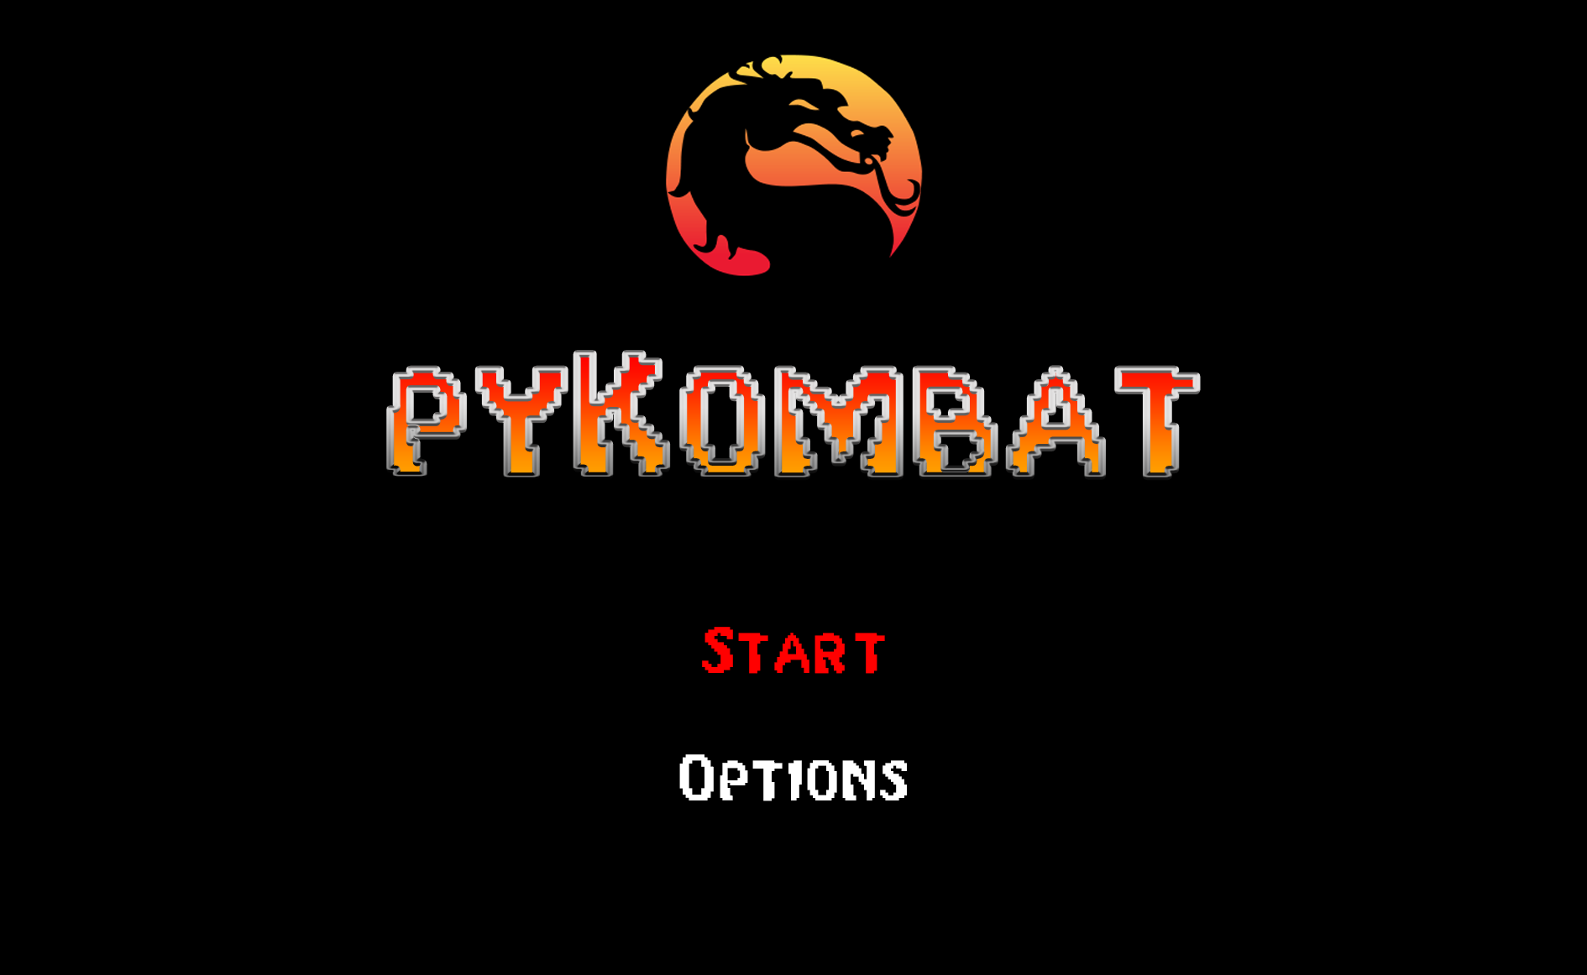



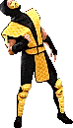


Menu

Slide 4


Choose your fighter
P1
P2

Slide 5
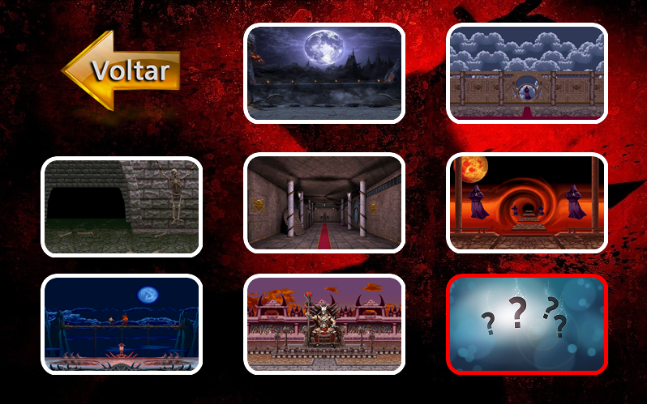


Scenarios

Slide 6
Steps
The Idea
Planning

Slide 7
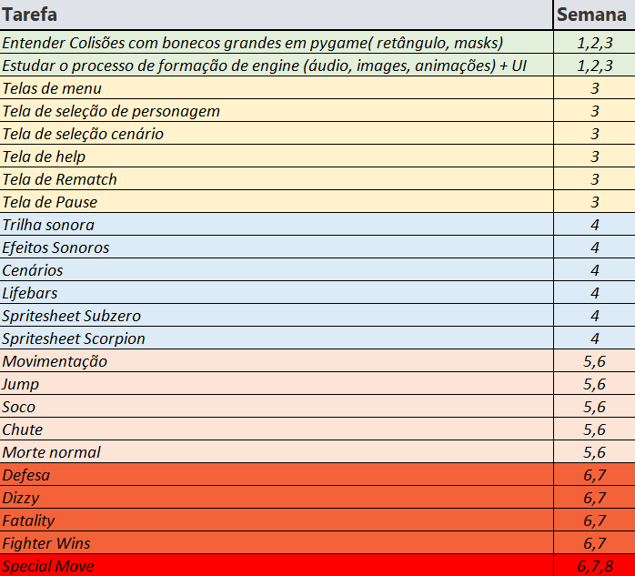

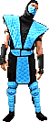
PLanning

Slide 8
Steps
programming
The Idea
Planning

Slide 9






Slide 10
Steps
Enjoy!
programming
The Idea
Planning

Slide 11
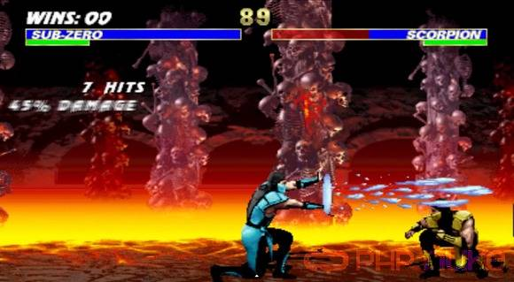
Almost Like mK2

Slide 12



Challenges
Special Moves
Bugs?
Fatality
PS4/Xbox Controller
Collision

Slide 13
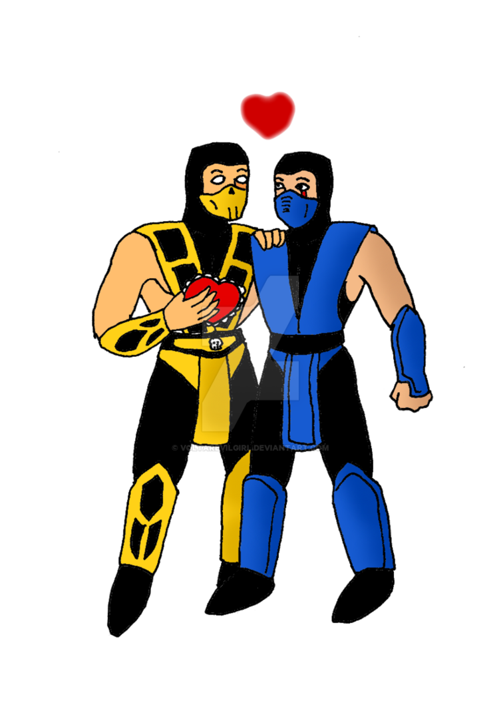
Thank you

